Slide 1
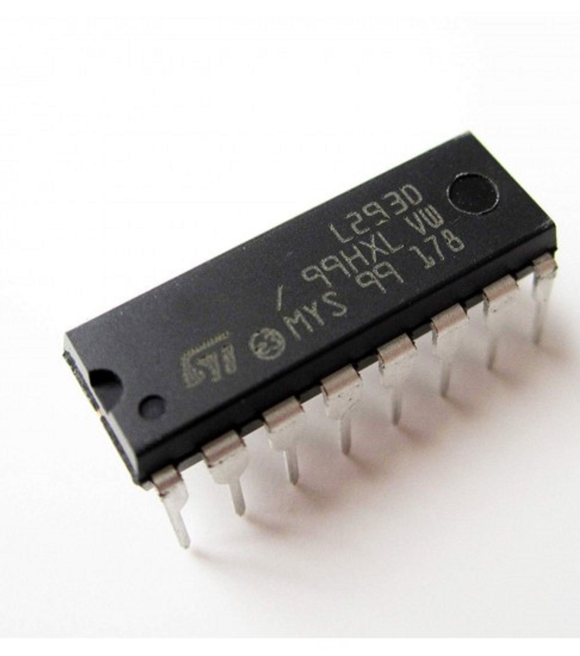
L293D H‑Bridge Motor Driver
Brief Datasheet Presentation

Slide 2
What is the L293D?
The L293D is a dual H-bridge IC that acts like a “bridge” between your low-power control signals (raspberry pi, Arduino and the high-power needs of motors (higher voltage, higher current). It ensures you can run motors safely without burning out your microcontroller.
It has separate logic and motor supplies which helps to transform the energy from low-voltage control signals into higher-voltage motor power, allowing small microcontrollers to safely drive larger motors.

Slide 3
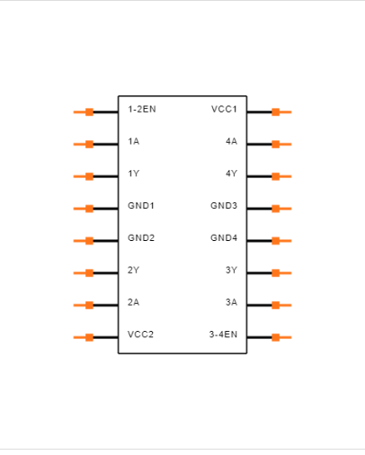
Pin Overview
Left side (Pins 1–8):
EN1,2 → Enable for OUT1 & OUT2 (active HIGH)
IN1 → Logic input 1 (controls OUT1)
OUT1 → Output 1 (to Motor A terminal)
GND → Ground
GND → Ground
OUT2 → Output 2 (to Motor A terminal)
IN2 → Logic input 2 (controls OUT2)
VS → Motor power supply (4.5 V to 36 V)
Right side (Pins 9–16):
EN3,4 → Enable for OUT3 & OUT4 (active HIGH)
IN3 → Logic input 3 (controls OUT3)
OUT3 → Output 3 (to Motor B terminal)
GND → Ground
GND → Ground
OUT4 → Output 4 (to Motor B terminal)
IN4 → Logic input 4 (controls OUT4)
VSS → Logic supply (typically +5 V)

Slide 4
3) Core Specs
Motor supply (VS): 4.5 – 36 V
Logic supply (VSS): 4.5 – 5.5 V
Output current: 600 mA per channel (cont.), 1.2 A peak
TTL‑compatible inputs
Switching: a few kHz typical

Slide 5
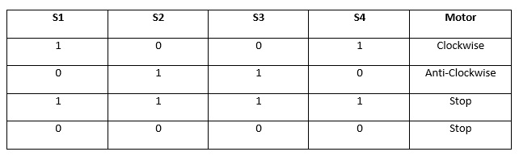
Truth Table

Slide 6
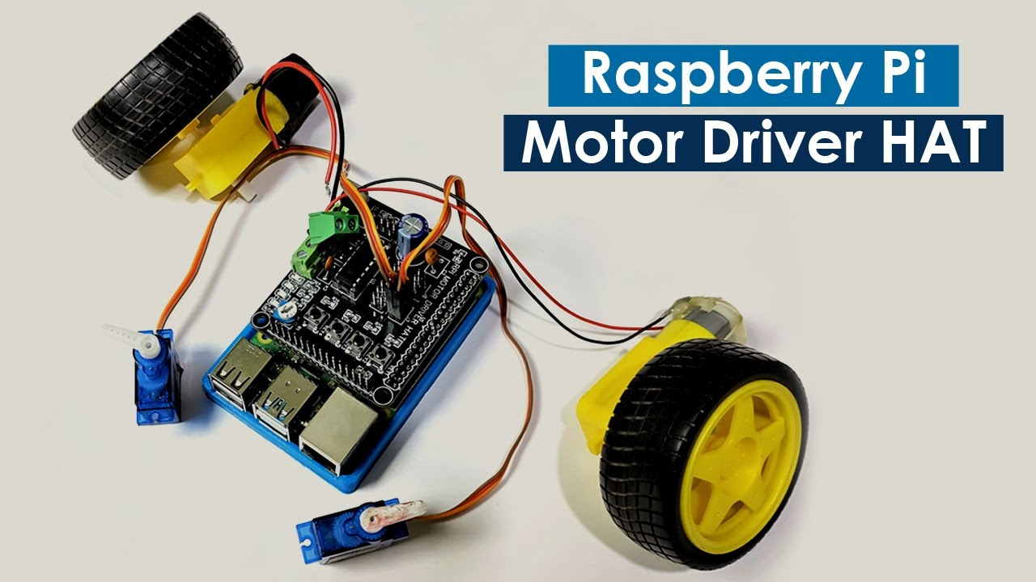
Application
- Microcontroller controls IN1–IN4
- PWM → EN pins for speed control
- Motor supply → VS, decoupling caps required
- Common ground for logic and motor

Slide 7
Key Points
Voltage drop reduces motor voltage
Thermal limit: 600 mA cont.
Internal clamp diodes protect against back‑EMF
No current limiting: choose motors carefully

Slide 8
Citation
https://th.bing.com/th/id/R.e69f2c56be144ea69c3a785037e337b7?rik=BqaTYRb5vfUCpA&riu=http%3a%2f%2f5.imimg.com%2fdata5%2fSELLER%2fDefault%2f2023%2f5%2f309490043%2fQT%2fSS%2fPD%2f2713384%2fl293d-motor-driver-ic.jpg&ehk=G%2bqIM9B%2fnGOMAq9P4EfFov7dLtSxzQEK3K7bzxxBb1I%3d&risl=&pid=ImgRaw&r=0 (Slide 1 Image)

Slide 9

Thanks for watching

